Slide 1

Introduction to AI and ML

Slide 2
Goal of this Lecture
The goal of this lecture is to:
Accurately define Artificial Intelligence, Machine Learning, and Deep Learning;
Understand the differences and similarities between these terms;
Understand the steps involved in Machine Learning;
Be able to identify the types of questions that Machine Learning solves.

Slide 3
Definitions, definitions and more definitions
1

Slide 4
Definitions
What is Artificial Intelligence? What is Machine Learning? What is Deep Learning?
These terms are related to one another, but all have different meanings. They relate to one another like a funnel:
Deep Learning is one type of Machine Learning, and Machine Learning is one type of Artificial Intelligence.

Slide 5
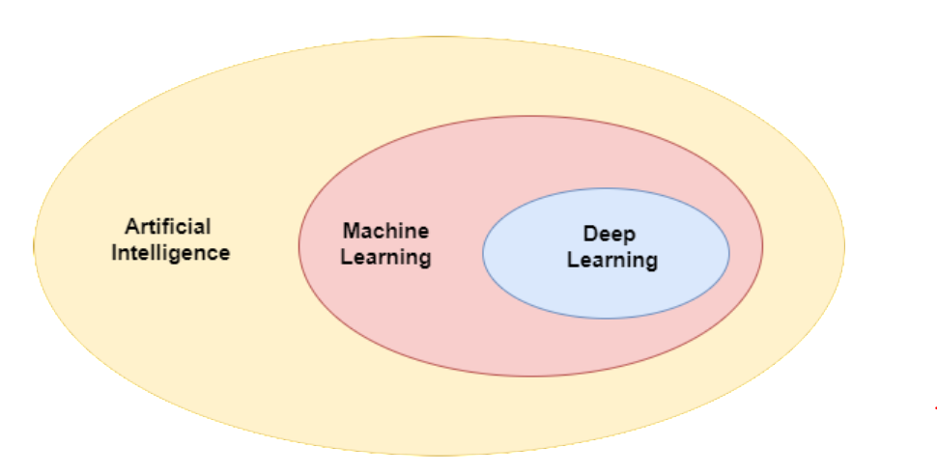
Definitions

Slide 6
Definitions
Artificial Intelligence is the area of computer science in which computers are taught to make decisions like humans, using perception, logic, and learning.
Within AI is Machine Learning, where algorithms are applied to data to enable computers to learn from past data to make predictions or decisions when shown new data.
Deep Learning is a type of Machine Learning that uses many-layered neural networks.

Slide 7
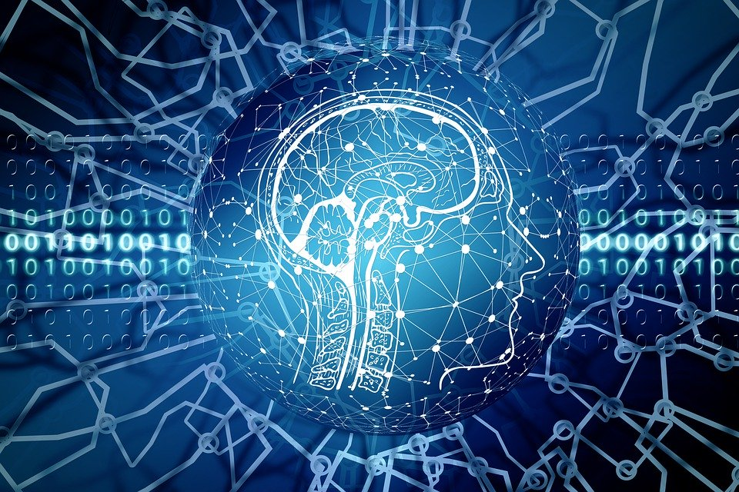
Definitions: AI
Artificial Intelligence is the ability of computers perform tasks that are commonly associated with 'intelligent' beings.
This can include simply making a decision based on the qualities of a particular input via logic (if X happens, do Y), to identifying patterns and forecasting patterns in data (learning) or understanding their environment (perception).

Slide 8
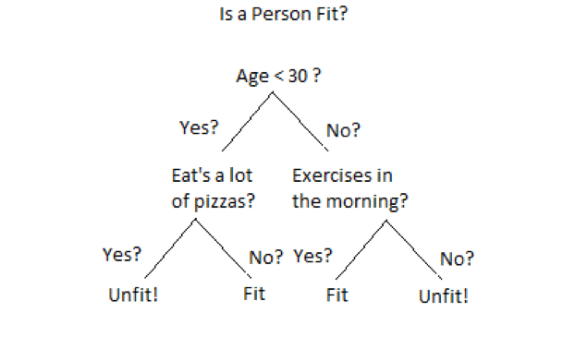
Definitions: AI
On the right, we see an example of what we would call rule-based AI. Here, the computer simply follows a logic of the type:
If condition == X:
Then…

Slide 9

Definitions: AI
However, there is a lot of statistics-based AI. Most machine learning algorithms use advanced statistical tools of the type:
P(y | x).
For example, we can have:
P(“rabbit” | “fluffy”, “white”, “young”, “small”)

Slide 10
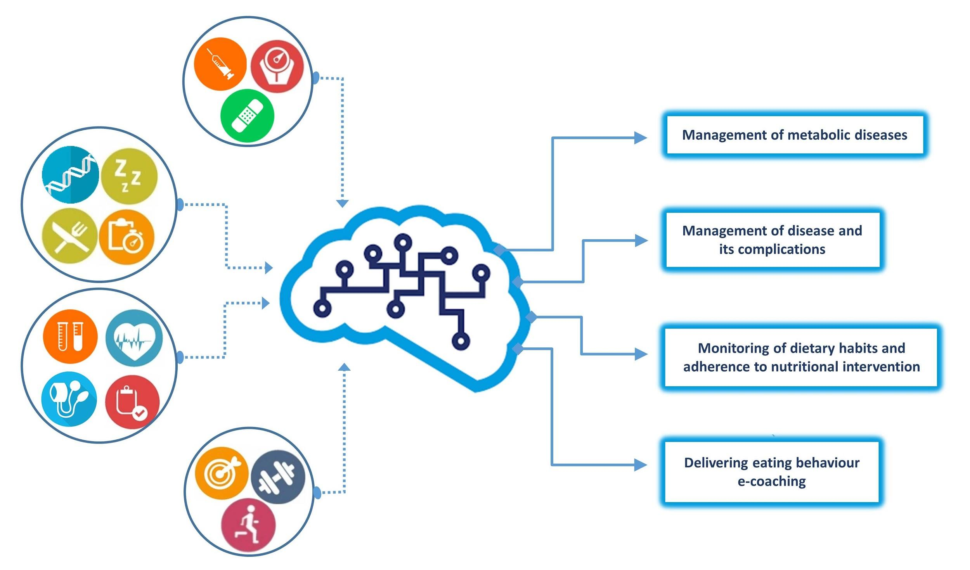
Definitions: ML
Machine Learning is a type of Artificial Intelligence in which algorithms (mathematical functions) learn from data by recognizing patterns, to make predictions or by making decisions.

Slide 11
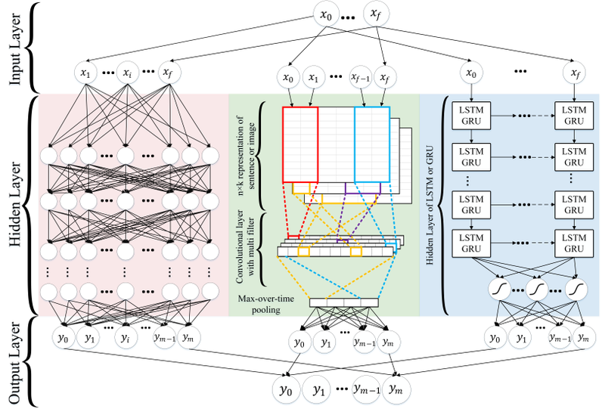
Definitions: Deep Learning
Deep Learning is a type of Machine Learning that uses a specific type of algorithmic structure called a deep neural network.
This technique is especially good at learning hard-to-find patterns in data, but requires a large amount of data to do so.

Slide 12
AI, why is it so big of a deal right now?
2

Slide 13
Why AI?
AI has been around for a long time (since the 1950s). It as become popular right now because of:
Technological advances (such as GPUs) have increased computing power and increased the amount of data computers can manage. This increase in processing power has made deep learning both much cheaper and much faster;
An increase in the availability of data.
In this module, we will look and discuss the power of AI and its implications for the modern world in much more detail.

Slide 14
Part II: ML Core Concepts
3

Slide 15
ML: Core Concepts
Machine Learning uses mathematical algorithms to find the patterns in data. The patterns that the computer has 'learned' through these algorithms can be applied to new data of a similar structure in order to make predictions about this 'new' data.
In this way, Machine Learning extracts 'insights' from data that we already have, and applies these insights to forecast the outcome for data the computer has never seen before.

Slide 16
ML: Core Concepts
Machine learning essentially boils down to the following process:
Input
ML Algorithm
Prediction

Slide 17

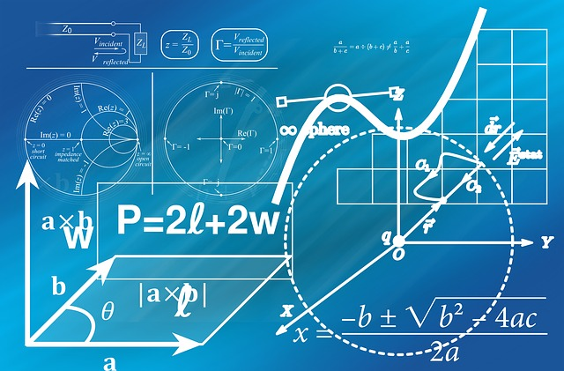
ML: Core Concepts
Machine learning essentially boils down to the following:
Input
Self-Driving Car Algorithm
Prediction
“Pedestrian”

Slide 18
ML Core Concepts: Regression
4

Slide 19
ML Core Concepts: Regression
There are two types of machine learning algorithms:
Regression algorithms;
Classification algorithms.

Slide 20

ML Core Concepts: Regression

Slide 21
ML Core Concepts: Regression
Thus, we may divide machine learning algorithms into two classes:
Classification: In this type of problem, we want to put a data instance into one of two or many groups based on its features, or characteristics. The outcome is categorical or binary.
E.g. given that we know the attributes of an animal (fur type, whiskers, ears, etc.) can we determine if the animal is a dog or a cat?
Regression: In these types of problems, the outcome is continuous: the data can take on any value within a particular range (though this range does not have to be clearly defined).
E.g. given that we know the attributes of a house (square footage, year built, pool, etc.) how much will it cost?

Slide 22
ML Core Concepts: Regression
Let us look at an example of linear regression.
Consider the relationship between age and height in children (older kids are generally taller than younger ones).
Here we have a model with two parameters: (1) the intercept (starting point) and (2) the beta coefficient. Let our model be:
Height = 10 + (9.5 * Age)

Slide 23
ML Core Concepts: Regression
Intercept
Beta coefficient
With this model, we can make predictions for unseen instances.
Model: Height = 10 + (9.5 * Age)
Prediction 1:
Height = 10 + (9.5*4.5) = 52.75
Prediction 2:
Height = 10 + (9.5*17) = 171.5
Height
Height
Age
4.5
17
Age

Slide 24
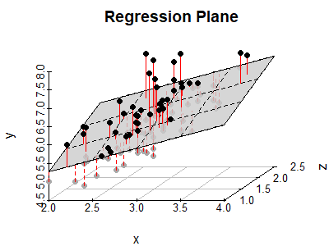
ML Core Concepts: Regression
But what if our relationship has more variables? Suppose we want to determine the (linear) relationship between 3 variables. In that case, we would make a multivariate regression model.
For instance, we may want to make a predictive model for a child’s height based on its age as well as its weight:
Height = 10 + (6.5 * Age) + (1.32 * Weight)

Slide 25
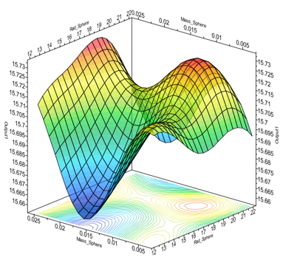
ML Core Concepts: Regression
But what if these relationships are not linear?
For instance, it may be that a model for determining a child’s height might look more like this:
Height = (1.3 * Age^2) / (sqrt(1.32 * Weight^3))
If we had to fit a non-linear model for 3 variables, we need more powerful ML algorithms than a simple linear regression model.

Slide 26
ML Core Concepts: Regression
And how about if we want to predict the relationship between more than 3 variables? For instance, maybe we want to make a prediction for a child’s height based on the following variables:
Gender;
Age;
Wealth of its parents;
Weight;
Scholing;
Medication;
Number of friendships;
Number of brothers or sisters;
Firstborn or not;
In that case we definitely want a more powerful algorithm than a simple regression model.

Slide 27
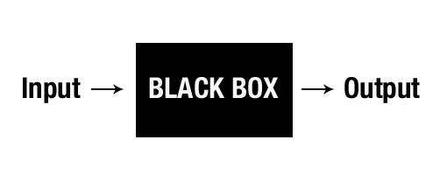
ML Core Concepts: Regression
In those cases, making very accurate predictions is still possible. However it will be impossible to visualise these kinds of relationships. For this reason, ML is also criticised for being too much of a black-box approach.

Slide 28
ML Core Concepts: Training and Testing
5

Slide 29
ML: Core Concepts Training and Testing
Training is the process by which the algorithm learns the patterns in the data. The algorithm is exposed to historical data, called the training set, and the parameters of the particular algorithm are adjusted to best fit those particular data.
Prediction is when this trained algorithm is exposed to new data and asked to predict the outcome.

Slide 30
ML: Core Concepts Training and Testing
Training (best model given training data)
Testing (how good is the prediction?)
Height
Height
4.5
17
Age
Age

Slide 31
Part III: Types of Machine Learning
6

Slide 32
Types of ML
There are many different types of machine learning, each of which are suited to a particular type of problem. Here we will discuss four types:
Supervised Learning;
Unsupervised Learning;
Reinforcement Learning;
Generative Learning.

Slide 33
Types of ML: Supervised
Supervised Learning. Types of problems in which we have a dataset for which we know the outcome labels are called supervised learning problems.

Slide 34
Types of ML: Supervised
Types of problems in which we have a dataset in for which we know the outcome labels are called supervised learning.
 | Colour | Top Speed (km/h) | Cylinders | MPG | Manufacturer (Label)
1 | Red | 321 | 6 | 30.2 | Ferrari
2 | Grey | 219 | 4 | 22.4 | Mercedes
3 | Red | 289 | 5 | 29.1 | Ferrari
4 | Blue | 192 | 4 | 18.4 | Ford
... | ... | ... | ... | ... | ...

Slide 35
Types of ML: Supervised

Slide 36
Types of ML: Unsupervised
Unsupervised learning. In these situations, we do not have a defined output that we can predict, because we don't actually know what the outcome is.

Slide 37
Types of ML: Unsupervised
For instance, suppose we have a group of customers. This is a very diverse group of people. If we want to target specific advertising to various types of people, we can use an unsupervised ML algorithms to create customer segments.
Assume that we have two dimensions (i.e. columns): age and yearly income.

Slide 38
Types of ML: Unsupervised
Age (0-90)
Income p/y (0-1.000.000)

Slide 39
Types of ML: Unsupervised
Age (0-90)
Income p/y (0-1.000.000)

Slide 40
Types of ML: Unsupervised
Age (0-90)
Income p/y (0-1.000.000)

Slide 41
Types of ML: Reinforcement
Reinforcement learning. This is a less common (and more recent) type of machine learning that enables a machine to learn through the process of trial and error.
While the two previous types use training sets from which the algorithms learn, in reinforcement learning, the algorithm learns through the feedback it receives. The computer makes an action, and receives positive or negative feedback about that action. It then learns which are 'good' and 'bad' actions.

Slide 42
Types of ML: Reinforcement
Reinforcement learning is when computers are taught to play games: they learn what are the winning move through trying many different moves and receiving feedback about the moves that they make. (Link) (Link)

Slide 43
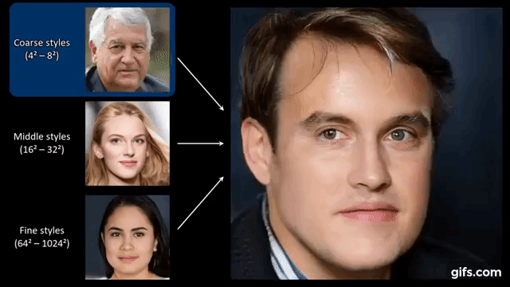
Types of ML: Generative
Nowadays it is also possible to generate new data using old data. These approaches work by competing two algorithms against each other during the training process.
For instance, GANs and VAEs (generative deep neural networks) can be used to create deep fakes.

Slide 44
Summary
7

Slide 45
Summary
Artificial Intelligence includes the areas in which computers use logic, perception, and learning to make decisions as a human would. Machine Learning is a type of AI in which computers learn through applying mathematical algorithms to data. Deep Learning is a type of Machine Learning in which deep neural networks are used;
In Machine Learning, the algorithm learns by looking at a subset of the data, the training set. We then evaluate it based on how well it predicts the outcome when it sees new data;
Machine Learning can solve both regression problems, where the outcome is continuous, and classification problems, where the outcome is discrete;
Supervised Learning finds patterns in data when we know the outcome variable and have values for it in the available data;
Unsupervised Learning finds patterns in data when the outcome variable is unknown;
Reinforcement Learning is the process of learning through trial and error.

Slide 46
The End.

